Slide 1
Exploratory Data Analysis: Bad Drivers Dataset
DSC 530
2/22/2020
Thanh Nguyen-Duong

Slide 2
Hypothesis
The percentages of driver involved in fatal collisions who were alcohol-impaired may have influence on the percentages of driver involved in fatal collisions who were speeding.
Dataset was obtained from:
https://www.kaggle.com/fivethirtyeight/fivethirtyeight-bad-drivers-dataset

Slide 3
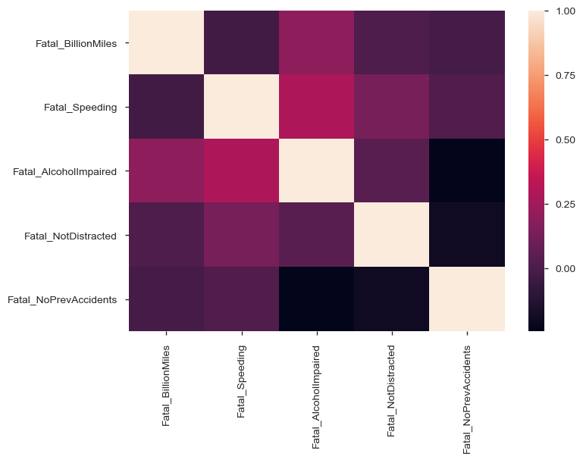
Correlations between all variables

Slide 4



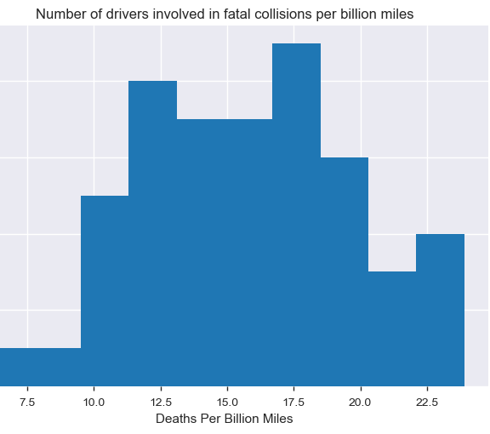


Variables: Fatal_BillionMiles (Number of drivers involved in fatal collisions per billion miles)

Slide 5
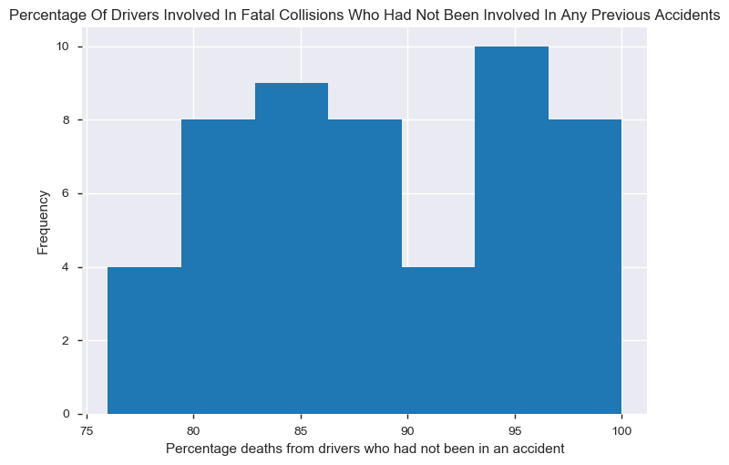
Variables: Fatal_NoPrevAccidents (Percentage of drivers involved in fatal collisions who had not been involved in any previous accidents)

Slide 6
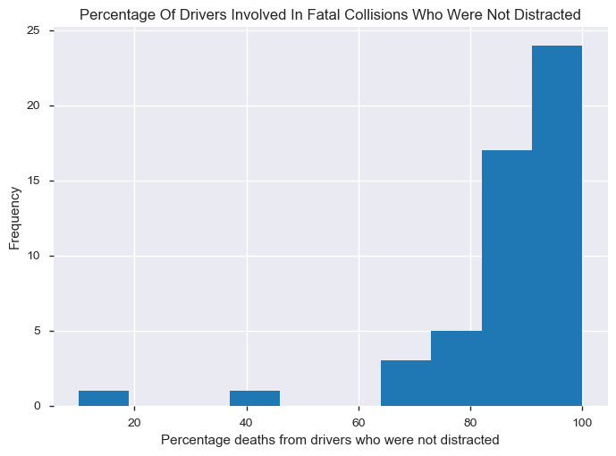
Variables: Fatal_NotDistracted (Percentage of drivers involved in fatal collisions who were not distracted)

Slide 7
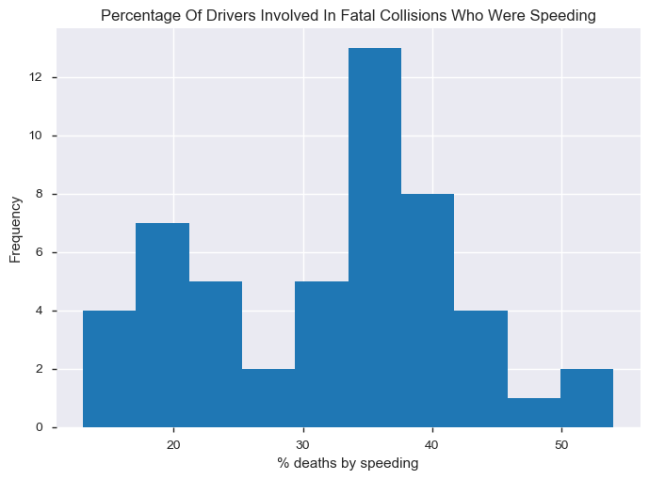
Variables: Fatal_Speeding (Percentage of drivers involved in fatal collisions who were speeding)

Slide 8
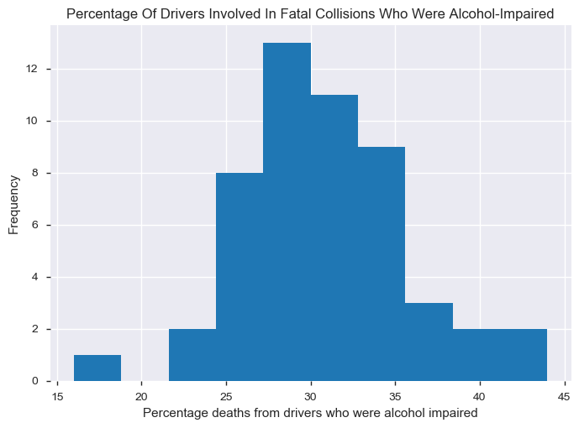
Variables: Fatal_AlcoholImpaired (Percentage of drivers involved in fatal collisions who were alcohol impaired)

Slide 9
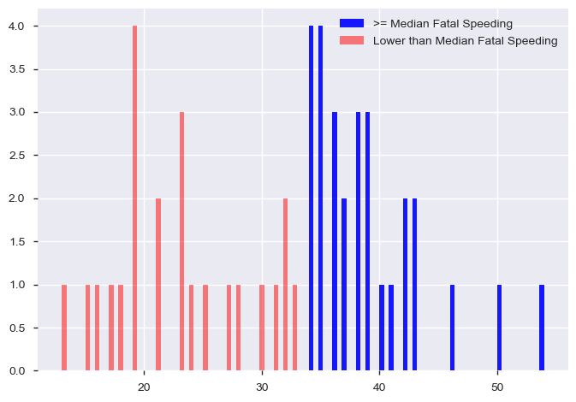
Probability Mass Function (PMF)

Slide 10
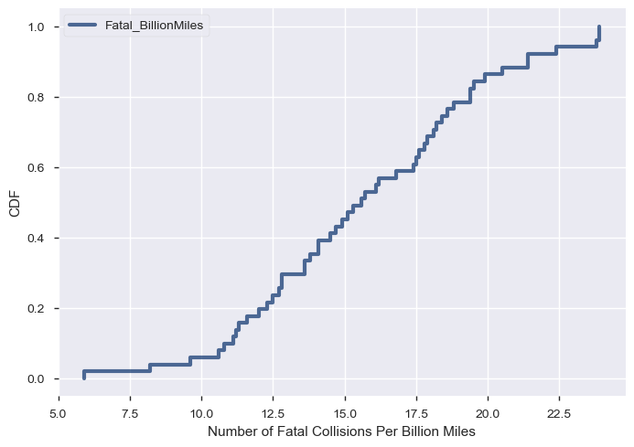
Cumulative Distribution Function (CMF)

Slide 11

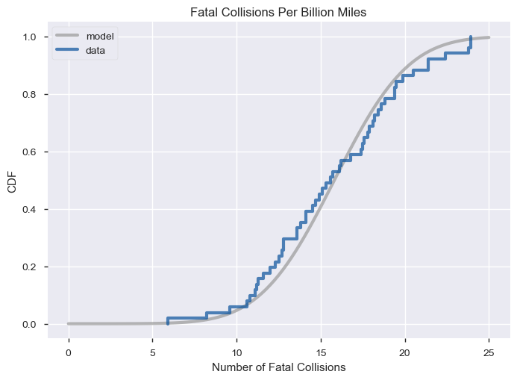
Analytical Distribution

Slide 12
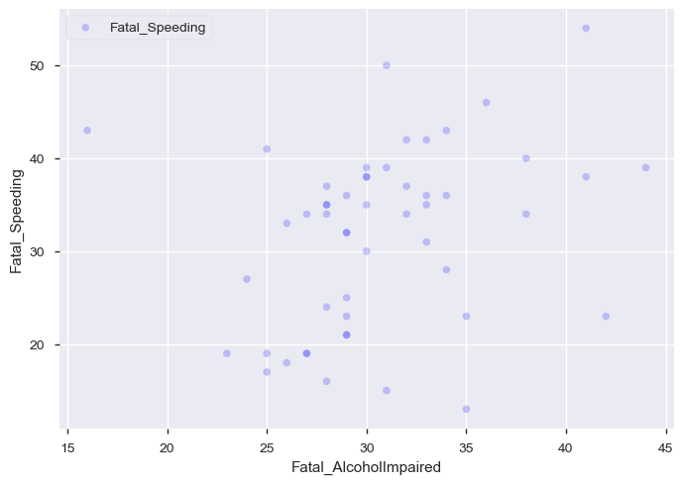
Scatter Plots: Fatal_AlcoholImpaired vs. Fatal_Speeding

Slide 13
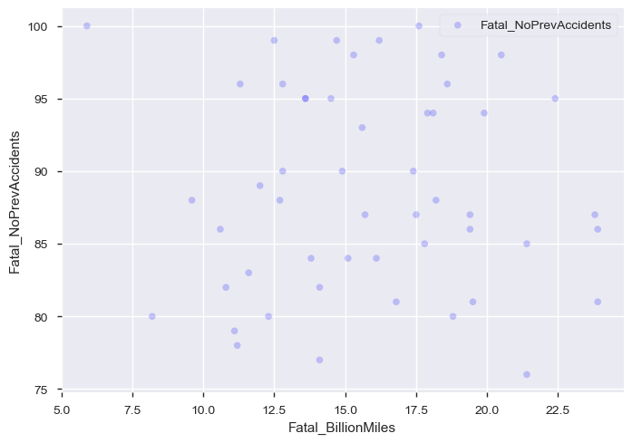
Scatter Plots: Fatal_BillionMiles vs. Fatal_NoPrevAccidents

Slide 14
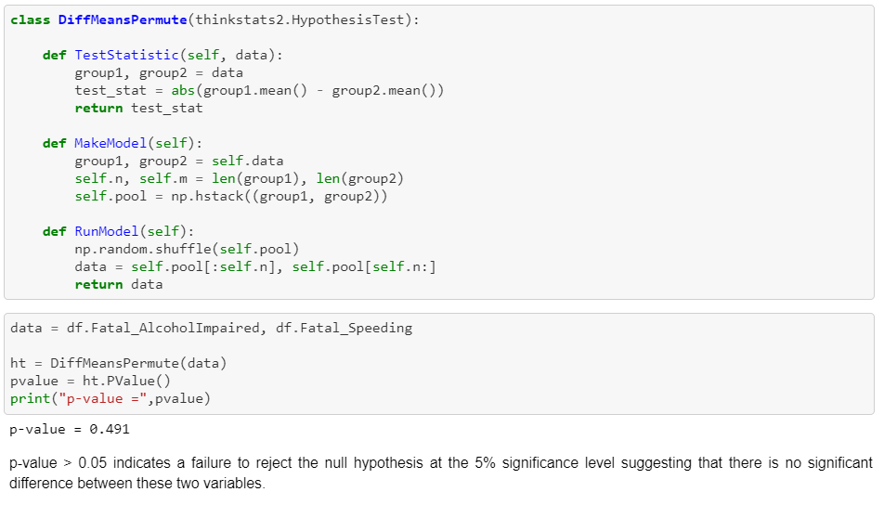
Hypothesis Testing

Slide 15
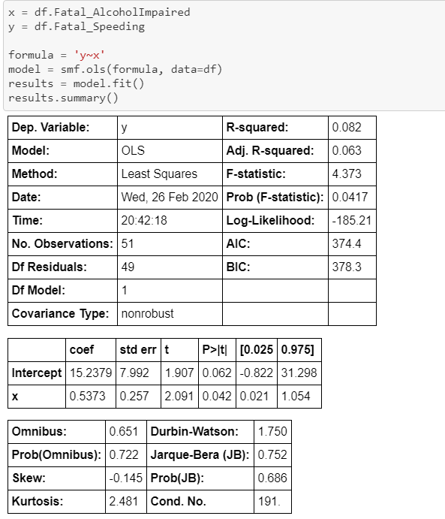
Regression Analysis Fatal_AlcoholImpaired vs. Fatal_Speeding

Slide 16
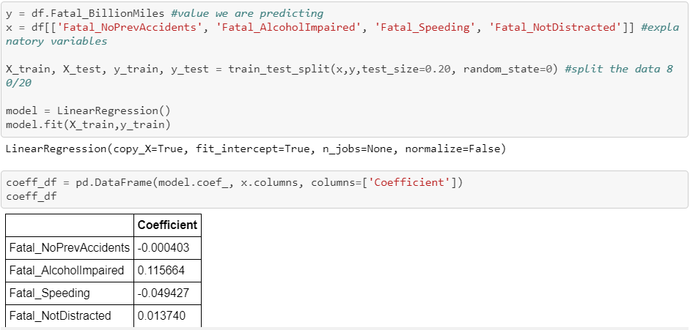
Regression Analysis: All variables

Slide 17
Thank you
The End

